Slide 1
Finite model for infinite media
By:-jubin kumar soni

Slide 2
Introduction
The rational approach to analytical studies of sonic flaw detection methods , blast effects , foundations vibrations is to consider them as wave propagation problems in an infinite solid.
This approach has two major advantage:
1.The radiation of energy from the exited zone to the far field is properly accounted
2.Infinity is mathematical term but our aim is to find closed form of analytical solution

Slide 3
A general method through which an infinite system may be approximated by a finite system with special viscous boundary condition is mentioned in this paper
This paper tries to demonstrate :
The near equivalence between an infinite half space and proposed finite model

Slide 4
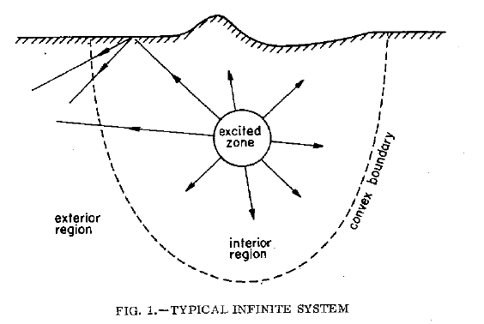
Consider an imaginary convex boundary enclosing all sources of disturbance and all irregular geometrical features.
Propagation of energy will only occur from all the interior to exterior region
all energy arriving at boundary will pass into exterior region.

Slide 5
The effect of exterior region on the interior region is therefore identical to that of an energy absorbing or non reflecting boundary
This observation relates to determining the dynamic response of the interior region of a finite model which is subjected to a boundary condition that ensures that all energy arriving at the boundary is absorbed.

Slide 6
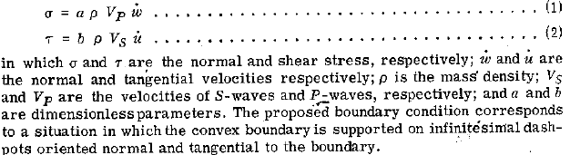
The most appropriate way to express this boundary condition analytically is:

Slide 7
Reflections at viscous boundary
It is necessary to study reflection of elastic wave at the viscous boundary defined in above two equations in order to determine appropriate parameters a and b.

Slide 8

Incident P-wave
An incident P-wave is taken where the x-axis represents the viscous boundary and the elastic medium is located in lower half plane.
The incident wave generates two reflected waves, an S-wave which travels with the velocity

Slide 9
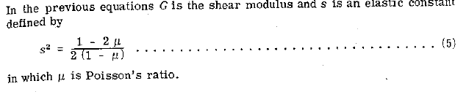
And a P-wave which propagates with the velocity

Slide 10
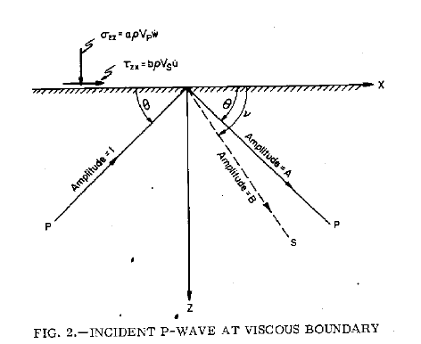

Slide 11
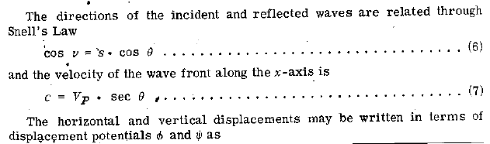


Slide 12
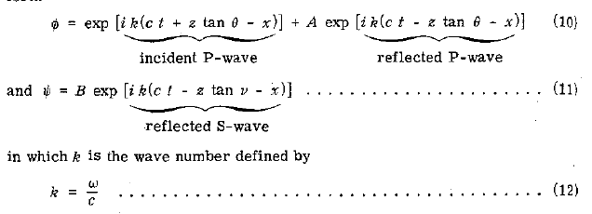

Slide 13

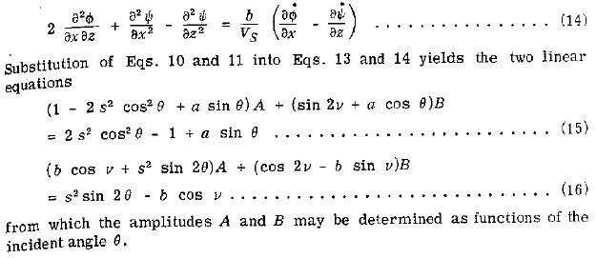
Amplitudes may be determined by the stress boundary condition defined in equation 1 and equation 2 which may be expressed in terms of displacement potential as follows:

Slide 14
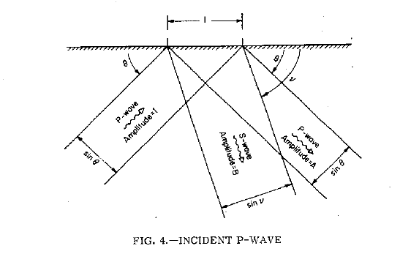

Slide 15
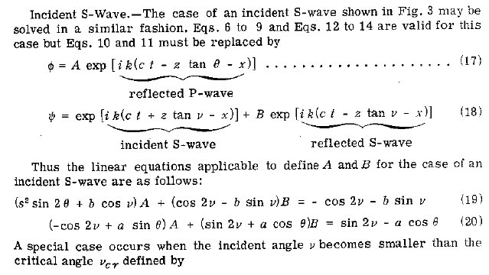
Incident s-wave

Slide 16
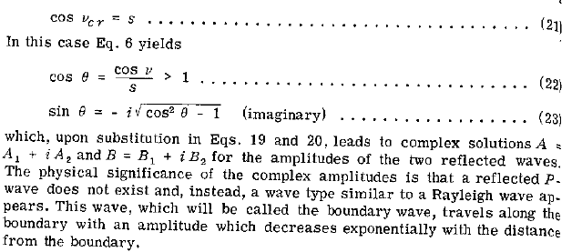

Slide 17
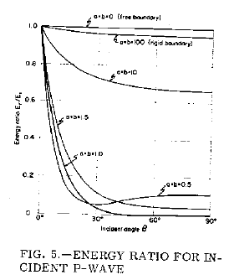
Energy consideration

Slide 18
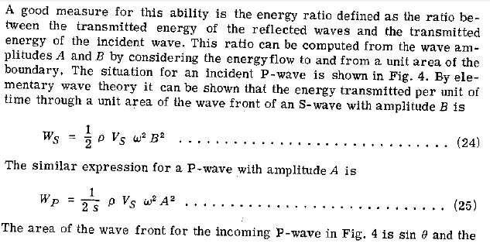
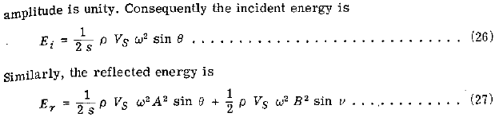

Slide 19
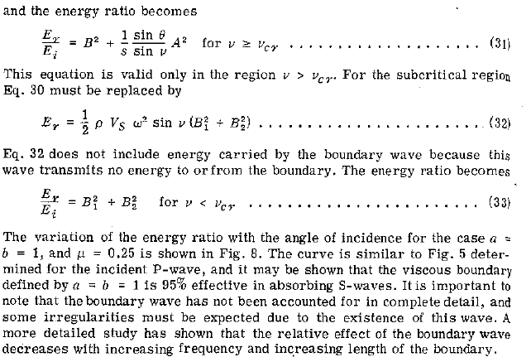

Slide 20
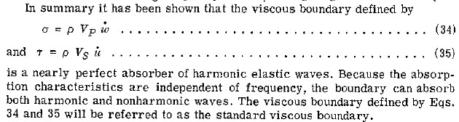

Slide 21
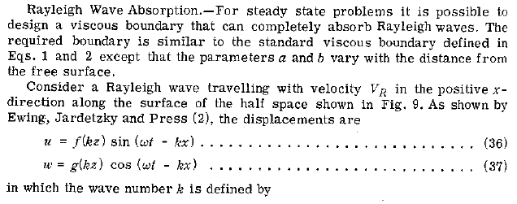
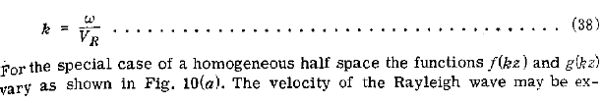
Rayleigh wave

Slide 22
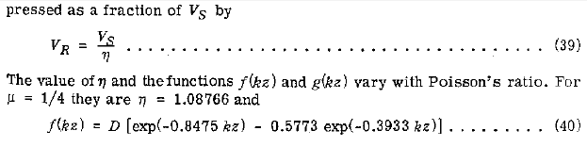
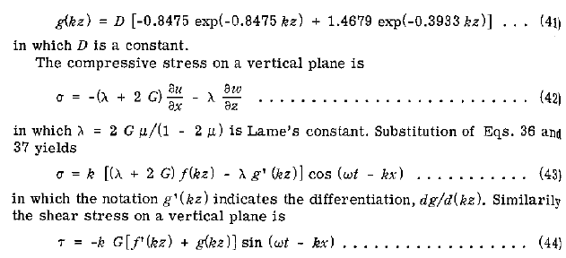

Slide 23
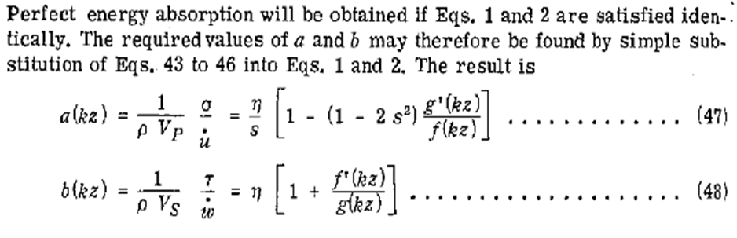
At depth greater than half wavelength of a and b approach constant values
At a depth where horizontal displacement vanishes parameter a goes to infinity which agrees with the physical fact that an infinitely viscous dashpot is required to fix a point

